Slide 1
2023 Hyland Hackathon
WELCOME
tinyurl.com/
hackhyland2023
Wi-Fi Network: Hackathon
Password: HylandSoftware!

Slide 2
tinyurl.com/ hackhyland2023
Everything you need to know for the Hackathon, all in one place!

Slide 3
🛣️
Pathways
Make the most of your Hackathon experience
FOLLOW

Slide 4
Choose a Track
Explorer
Artisan
Scientist
🚀
🖌
🧪
For students who are just beginning their voyage into the world of software development
For students with some programming experience who are interested in the creative aspects of development
For students who love the technical details of projects and have significant programming experience

Slide 5
Workshops & Sessions
Hacky Hour
UX
Intro to Git
Building a Website
OpenAI
Programming Synthwave
👩‍💻
🤳
🍴
Friday, 5-6PM ET
Friday, 6:30-7:15PM ET
Friday, 8-9:30PM ET
🕸
🤖
🎹
Friday, 8-9:30PM ET
Saturday, 3-3:30PM ET
Saturday, 6:45-7:30PM ET
Full activity schedule available at tinyurl.com/hackhyland2023

Slide 6
Important Times
Friday 5pm ET
Saturday 11pm ET
Sunday 3pm ET
Teams Due
Ideas Due
Code Cut Off
Assemble your team
and submit your members
Submit a short description
of your team’s project idea
All development work
must stop

Slide 7

Discord Communication
TBD

Slide 8
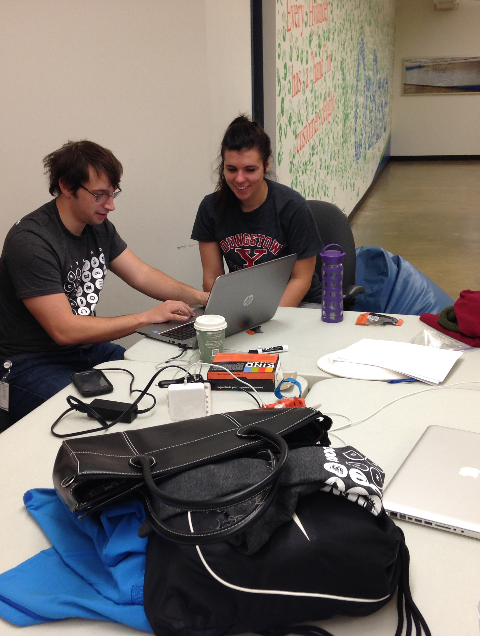
Mentors
These technology professionals will be an excellent resource for you as you learn new concepts and work on your projects.
More info TBD

Slide 9
📏
Guidelines
PROSPERITY
Follow these rules to ensure your success

Slide 10
Code of Conduct
TBD

Slide 11
Competiton Rules
Fresh Code
Ownership
As you develop your project, keep these guidelines in mind
Only work created during the Hackathon is allowed to be included in your submission
Teams have full ownership of projects created during the Hackathon

Slide 12
Judging Criteria
Innovation
User Interface
Quality
Impact
💡
📱
Is your project new and cutting-edge?
Is your product
user-friendly?
📈
🤍
Does your code work as intended?
Does your solution make a positive difference?

Slide 13
🏆
Prizes
2023 Hyland Hackathon

Slide 14
Raffle Prizes
Earn Raffle Tickets throughout the weekend by attending activities, helping others, asking great questions, and participating.
Each ticket you earn will give you one more chance to win!

Slide 15
Physical Prizes
🍭
Candy Bag
💧
Water Bottle
🦆
Rubber Ducks
👜
Grab Bag
🧸
Stuffed Animal
Yum!
Ahh!
Quack!
Assorted!
Cute!
IN-PERSON
Notes:
Candy – assorted candy bags
Rubber Ducks - https://www.amazon.com/SmartYeen-Toddlers-Assorted-bathtime-Birthday/dp/B0B4CDBDS9/
Stuffed animals - https://www.amazon.com/TeeTurtle-Reversible-Octopus-Mini-Plush/dp/B07H4HKDG7, https://www.amazon.com/dp/B09ZXTGRMY/, https://www.amazon.com/Aurora-World-Rolly-Prankster-Plush/dp/B01MZFBOVV/, https://www.amazon.com/Aurora-World-31290-Foxxie-Plush/dp/B004JRR5BM/, https://www.amazon.com/Melissa-Doug-Stuffed-Washable-Surface/dp/B004N7NFSK/
Squishmallow - https://www.amazon.com/dp/B09NB3QP1P/, https://www.amazon.com/dp/B09NB1QQWC/, https://www.amazon.com/Squishmallow-Official-Kellytoy-Ultrasoft-Stuffed/dp/B08G1W7G93
Water Bottle – hyland branded
Grab bag – USB sticks, extra swag, sunglasses

Slide 16
Digital Prizes
🎧
Audible Credit
🎹
Bonus Track
🖼
A.I. Portraits
🖋
A.I. Poetry
🏫
Udemy Course
Literary!
Musical!
Artistic!
Iambic!
Educational!
VIRTUAL
Notes:
Audible credit - https://www.audible.com/ep/giftcenter
A.I. Portraits – Matt can generate through DALL-E
A.I. Poetry – Matt can generate through GPT-3
Bonus Track – Joseph can create a custom synthwave track
Udemy Course - https://support.udemy.com/hc/en-us/articles/229231187-How-to-Send-a-Udemy-Gift-
(note for udemy courses – the prices might go way up, so we should have a backup plan)

Slide 17

Grand Prizes
The judges will select the top two teams from each level. Each member will win one of these valuable prizes…

Slide 18

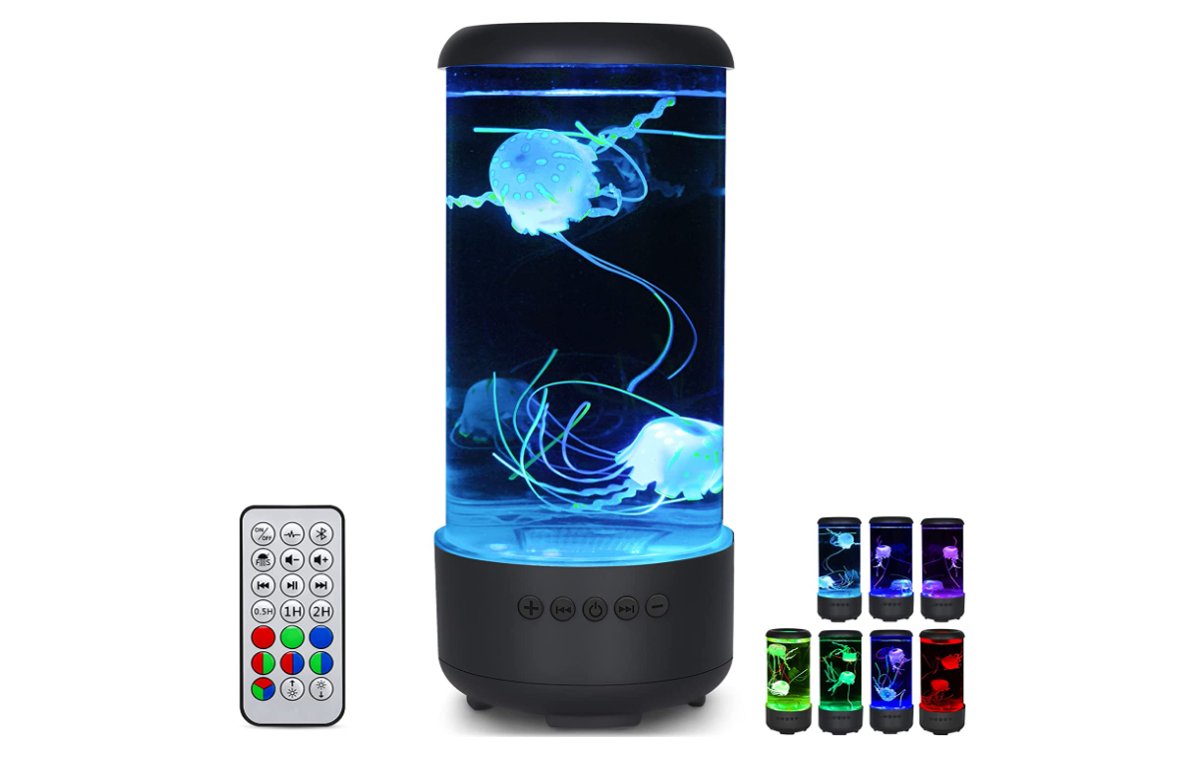
Second Place: Pick One
Pixel Art Bluetooth Speaker
LED Jellyfish Lamp
Notes:
LED lamp: https://www.amazon.com/dp/B0B8R4T5HX/
Pixel Art Speaker: https://www.amazon.com/dp/B0811XB8VB/ref=cm_gf_acbr_iaac_d_p0_e0_qd0_NUOdAM3fFvGTmlUdfhxg

Slide 19
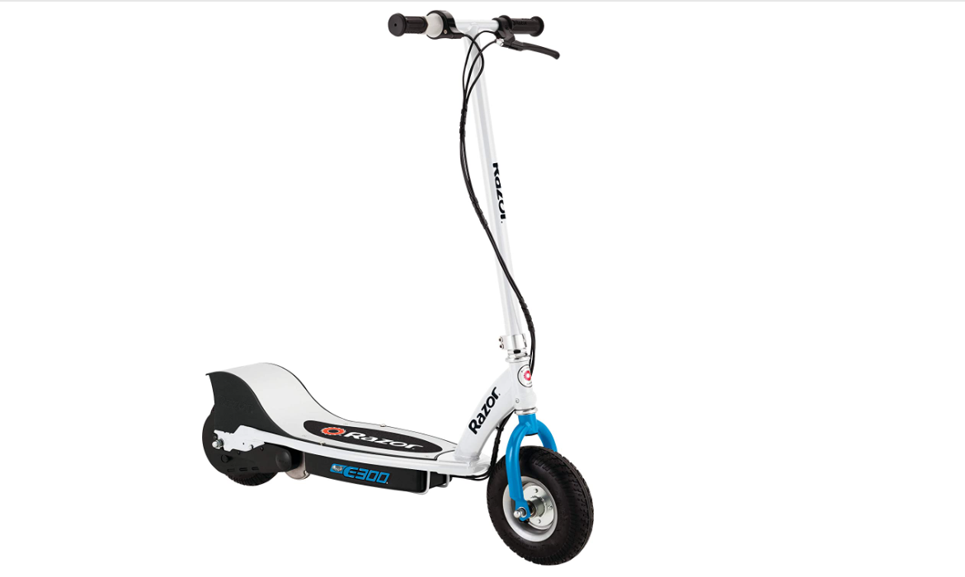
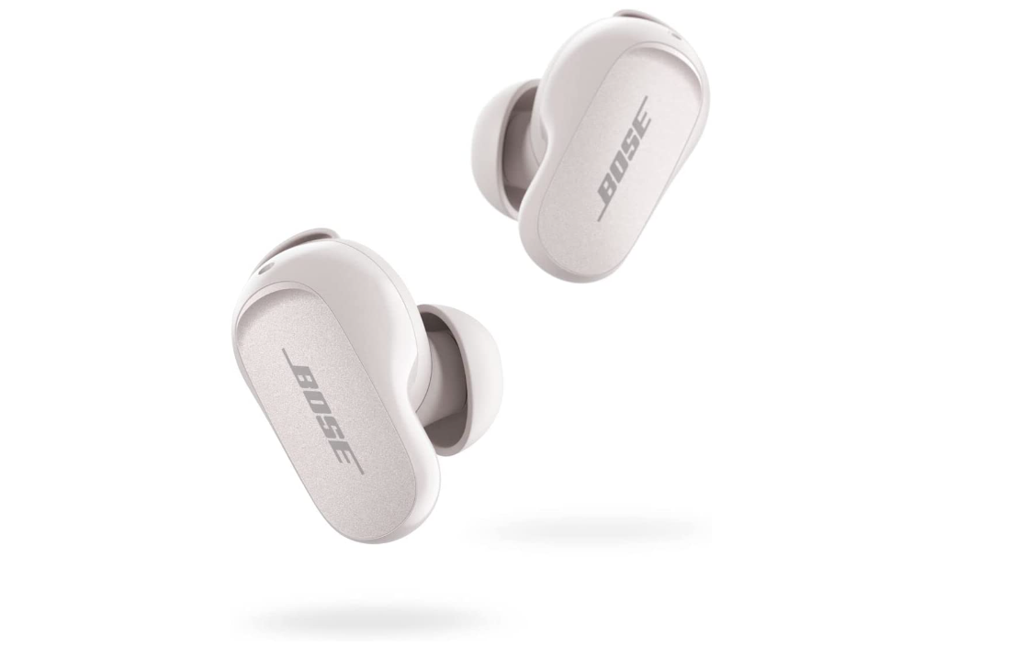
First Place: Pick One
Electric Scooter
Bose Noise Cancelling Earbuds
Notes:
Bose Earbuds: https://www.amazon.com/dp/B0B7838HH6/
Electric Scooter: https://www.amazon.com/Razor-E300-Electric-Scooter-White/dp/B083G8KWCY

Slide 20
Good Luck!
2023 Hyland Hackathon

Slide 21
🏢
In-Person Info
Thank you for joining us at Hyland’s Headquarters

Slide 22
Workstation Map
TDB

Slide 23

Contact
Emergency
Facilitators
Discord
🆘
Call: 911
Desk Phone: 9-911
Marissa: (216) 314-7660
Joseph: (216) 218-2609
Caitlin: (216) 469-4921
Visit the Mentor Room
Reach mentors and event facilitators online
More information at tinyurl.com/hackhyland2023

Slide 24
Food & Beverages
TBD

Slide 25
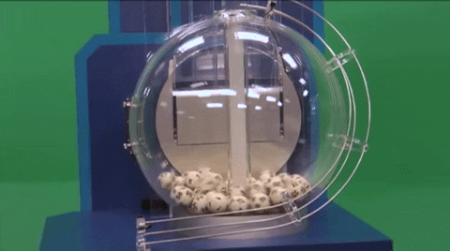
Room Lottery

Slide 26
Raffle Room Map
TDB

Slide 27
Questions?
THANK YOU

